Slide 1


DayWorkers365.

Slide 2
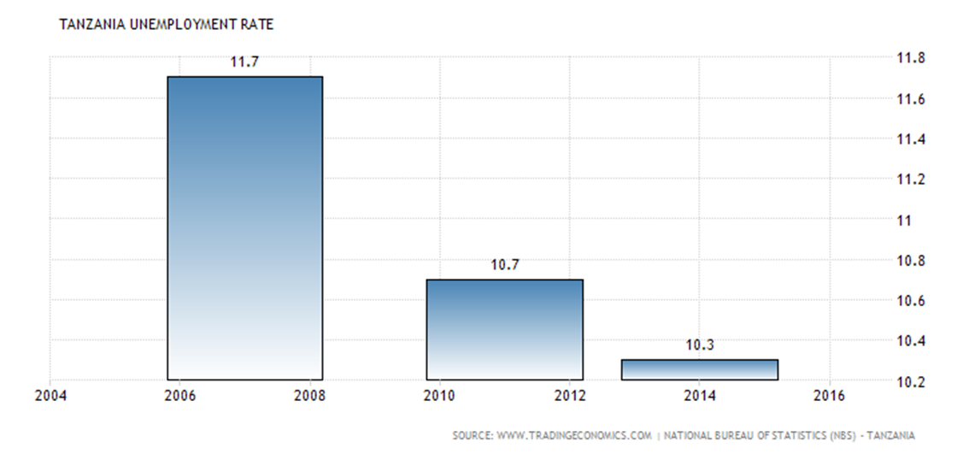


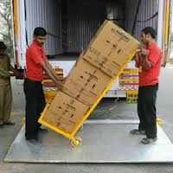
According to a U.S. study on Day Labor in 2006:
Approximately 117,600 workers are either looking for day-labor jobs or working as day laborers on any given day.
The vast majority (79%) of hiring sites are informal and include workers standing in front of businesses (24%), home improvement stores (22%), gas stations (10%) and on busy streets (8%).
1 out of every 5 day laborers (21%) search for work at day-labor worker centers.
According to data from the International Labour Organisation (ILO) in sub-Saharan Africa, the youth unemployment rate hovers around 12 percent. While this is slightly lower than the global youth unemployment rate of 12.4 percent, the African region has the world's highest rate of working poverty -- people who are employed but earning less than US$2 a day.
According to ILO, Despite being Africa's most educated generation to emerge from schools and universities, a youth in Africa is twice as likely to be unemployed when he/she becomes an adult.

Slide 3
Our Mission.
To become the world leading platform that helps individuals or companies to have quickly access to the nearest experts to resolve their problems which require emergency attentions. Also to improve the economy of the people around the world by giving them connections to the available daily Jobs which match with their expertise in their nearest areas.

Slide 4
Goals and Objectives
In the next five years we want be one of the biggest global players that help to improve economy of the people around the world by connecting them with the millions of work opportunities in the easily and fast way.
Our main objective is not to improve the world employment rate but improving the economy of the people by letting them earning whatever money necessary in the easily and fast way without changing their employment status.

Slide 5
Global Jobs Searching Market.
Currently there are literally thousands of job sites on the web with the advanced search options that allow finding of the decent jobs that are the best match for your skills, qualifications and interests.
None of these websites has started to offer the feature that would allow individuals or companies with the emergency needs of professional help to be connected with the appropriate nearest and qualified experts very fast.
Dayworkers365 as the first mover to introduce this solution we are expecting to have positive responses from the millions of people around the global with the different expertise but due to labour market status they find them self unemployed or not getting enough money from their monthly payments jobs.
To get a qualified person to perform your tasks efficiently can be a time consuming and sometimes can involve some costs. We believe by connecting experts and people who are looking for their emergency help will attract more individuals and companies to use our platform efficiently.

Slide 6
Opportunities.
The final figure for unemployment in 2015 was estimated to stand at 197.1 million and in 2016 was forecasted to rise by about 2.3 million to reach 199.4 million. An additional 1.1 million jobless will likely be added to the global tally in 2017, according to the ILO’s World Employment and Social Outlook Trends(2016).
“Many working women and men are having to accept low paid jobs, both in emerging and developing economies and also, increasingly in developed countries. And despite a drop in the number of unemployed in some EU countries and the US, too many people are still jobless. We need to take urgent action to boost the number of decent work opportunities or we risk intensified social tensions.” ILO Director-General Guy Ryder
Millions of job opportunities are created in the world every year but with the total population of 7 billion only 3 billion are employed and 205 millions are unemployed. Most jobs which are posted by the popular job searching websites are the decent works and the end to end process to get hired is very complex for most cases.
We believe there are millions of informal job opportunities which are being created everyday and if there will be a efficient way of connecting the unemployed societies with these opportunities then this will help enough to boost their daily incomes.
DayWorkers365 will mainly focusing on the those informal job opportunities which most of companies or individuals think there is no need to advertise them through their websites or job posting websites due to their urgent or job’s limited timeline.

Slide 7

DayWorkers365 – How Does It Work.
Day Worker/Experts Seeker.
Access the platform and complete the registration. Job poster will have different types of the account packages. There will be different payment agreements with the job posters depending on their account types. (Prepaid or Post paid) Can post the job any time. Can received the JOB acceptance notification. The acceptance notification pop up with the google map which show the location of the expert/worker, distance and the link to review the full expert profile. Can review the profile of the nearest expert who accept the job. Can cancel the acceptance and put the job available again.
Day Job Seeker.
Access the platform and complete the registration. Can change status Offline/ online. When put online status they start to receive the notifications of the nearest available Jobs which matches with their expertise. The available job notifications pop up with the google map which show the location of the jobs, distance, job descriptions and payment amount. Can accept or ignore the job . When they accept the job then other people won’t be able to see the job again.(Depending on required headcounts) Once they accept the Job then the job posters will be able to review their profiles and if satisfied then will contact them right a way or cancel the acceptance. Can receive notification upon the cancellation of the acceptance. And the job will be available again for other people to accept.

Slide 8
DayWorkers365 – What kinds of Jobs?.
The following the example of the job which will be post our platform:
Cleaning House Painting Construction Industrial works Movers Sales agents Advertising agents. Waitress Short time consultations. Cooking. Baby sitting. Computer Technicians Car Technicians | Dog walking House maids. Security guards

Slide 9
Competition
Dayworkers365 will be the first platform to offer this kind of solution since the current existing job posting platforms are only focusing on posting the decent work opportunities therefore at the beginning we are not expecting completions but once the market respond positively to our solution then there will be definitely followers platforms to introduce other solutions similar to what we are about to officer the world. Being said that, we will be more creative as we grow to maintain the top position in the business as the first company to offer this kind of solution to the world.

Slide 10
The Team
Paul Kaiza
(Founder & CEO)
Board of Directors
Msafiri Lwihula
(COO)
Amos Samwel
(Op Manager)
Denis Msunga
(HRM)
Ema Masingisa
(Finance Mgr)

Slide 11
Resource Requirements.
The successful launching of the solution will depend on the availability of the following resources:
  Personnel.
  To start the business we will require five full time committed people as follows:
  CEO: Lead strategies development and implementation of short and long term plans in accordance to company’s strategies.
  COO: Overseeing the operations of the whole company.
  Operational Manager: Managing daily operations of the company.
  Human Resources Manager: Recruiting and hiring employees and overseeing compensation, benefits administration and all processes related to the people side of a business.
  Finance Manager: Overseeing the flow of cash and financial instruments, Preparing reports as required by law, regulations or company policies and Ensuring compliance with applicable laws and procedures
  Technology.
  Well designed platform should be implemented to support the concept efficiently. The palatiform should be user friendly and flexible enough to support any change to support the business.

Slide 12
Resource Requirements. Cont..
  Finances
  We should be well abled on the financial side so that we can deploy the solution efficiently. There should be the capital budget of about 50,000 USD and the Operation budget of around 20,000 USD to accommodate the successful implementation and operations for six months.
  The required capital amount which mentioned above, will be utilized to develop the platform, setting up the appropriate business environment which including getting business license and other permits and to support several commercial activities before and after launching the service.
  Promotion
  To create the massive awareness of the our solution around the global we will use all advertising channels like other companies such as social media (we will set up different social media accounts, radio, television, workshops and billboards.

Slide 13
Financial Plan
Years : | Year one | Year two | Year three
Free Job Seekers Users: | 4,000,000 Users | 8,000,000 Users | 16,000,000 Users
Premium Job Seekers Users: (10$ @) | 500,000 Users | 1,000,000 Users | 3,000,000 Users
Revenue: | 5,000,000 $ | 10,000,000 $ | 30,000,000 $
Premium Business Users (50$ @) | 50,000 Users | 100,000 Users | 300,000 Users
Revenue 2 | 2,500,000 $ | 5,000,000 $ | 15,000,000 $
Premium Recruiters Users: (100$ @) | 100,000 Users | 200,000 Users | 600,000 Users
Revenue 3 | 10,000,000 $ | 20,000,0000 $ | 60,000,000 $
Total Users | 4,650,000 Users | 9,300,000 Users | 17,200,000 Users
Total Revenue | 17,500,000 $ | 35,0000,0000 $ | 105,000,000 $

Slide 14
Appendix
International Labour Organisation website: www.ilo.org

Slide 15
Thank you.

