Slide 1
Tiba Fasta We promote acess to health information & services.

Slide 2
Problem
WHO 2016:
20 Women die every day in Tanzania.
430 Children die everyday in Tanzania.
Tanzania has the 10th largest number of Newborn death globally.
NB: Lack of access to health information & services.

Slide 3
SOLUTION
TIBA FASTA: Promoting access to health information & services.
Social Media: Facebook, Twitter, Instagram
Publications: Medical Dictionary, Magazines
Link to health services: Medical Directory
Online Consultation & Mobile texts subscriptions

Slide 4
Market size:
Swahili Internet users
20M+ users in TZ (TCRA Report 2017)
Kenya, Burundi, Rwanda , DR Congo, Uganda
Global Swahili Speaker 200M+
Age 15+

Slide 5
Business Model:
Direct Sales
Partnership
Adverts on products
Consultation fee

Slide 6
Distribution
~ Website, Social Media, Mobile App
~ Magazines & Book Sellers
~ Mobile texts subscription

Slide 7
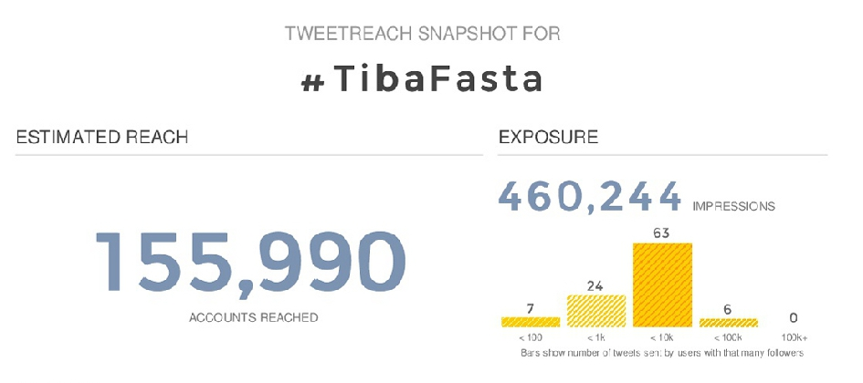
Traction

Slide 8
Competetition
~Daktari Mkononi
~Tanzmed
~Doctor Fasta

Slide 9
Team
Dr. Joachim Mabula
Founder & CEO
Spino Habib Rashid:
Health Information Expert

Slide 10
What we need
USD 35,000:
Website creation USD 5,000
Content creation USD 20,000
Mobile App creation USD 5,000
Branding & Marketing USD 5,000
Total USD 35,000

